Slide 1
High-Resolution Carbon Monitoring and Modeling:
Continuing Prototype Development and Deployment
George Hurtt, UMD
Richard Birdsey, USFS
Molly Brown, GSFC
Ralph Dubayah, UMD
Phil DeCola, Sigma
Vanessa Escobar, GSFC
Andrew Finley, MSU
Chengquan Huang, UMD
Kristopher Johnson, USFS
Jarlath O-Neil-Dunne, UVT
NASA-CMS Science Team Meeting
November 14, 2014
DEPARTMENT of GEOGRAPHICAL SCIENCES

Slide 2
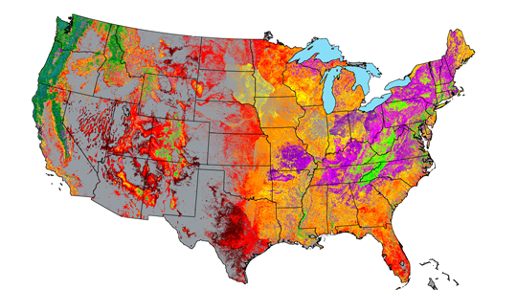
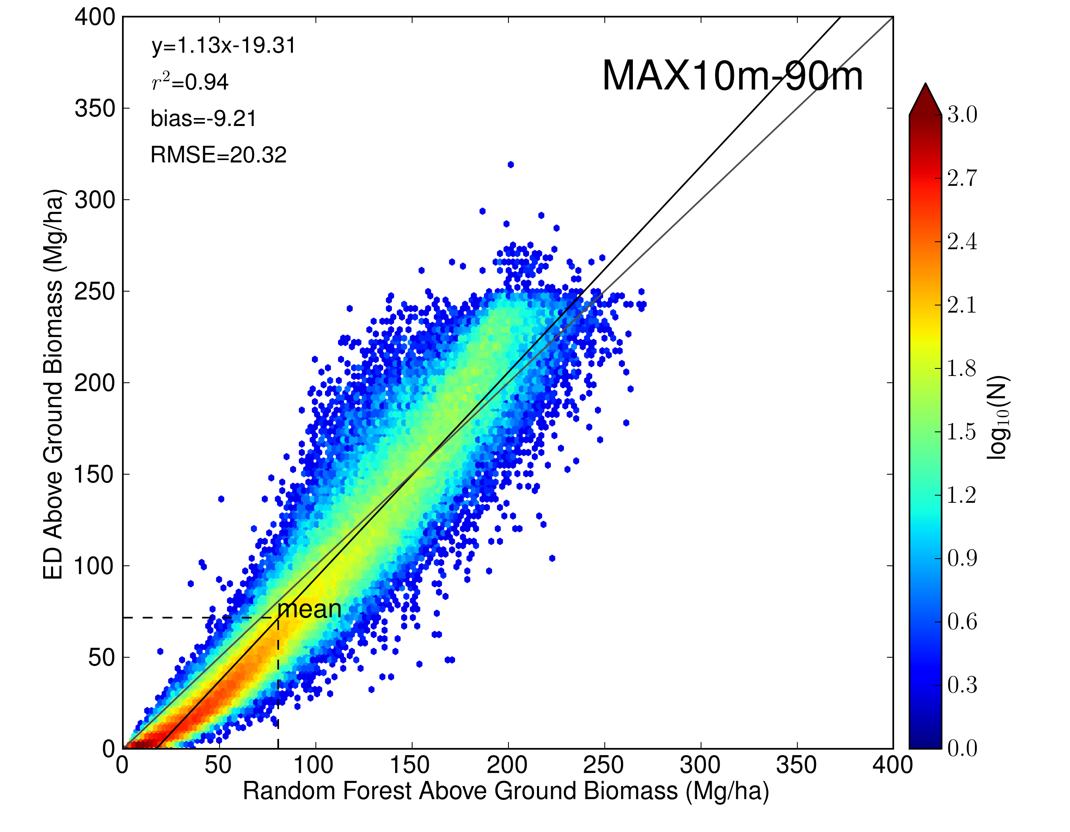
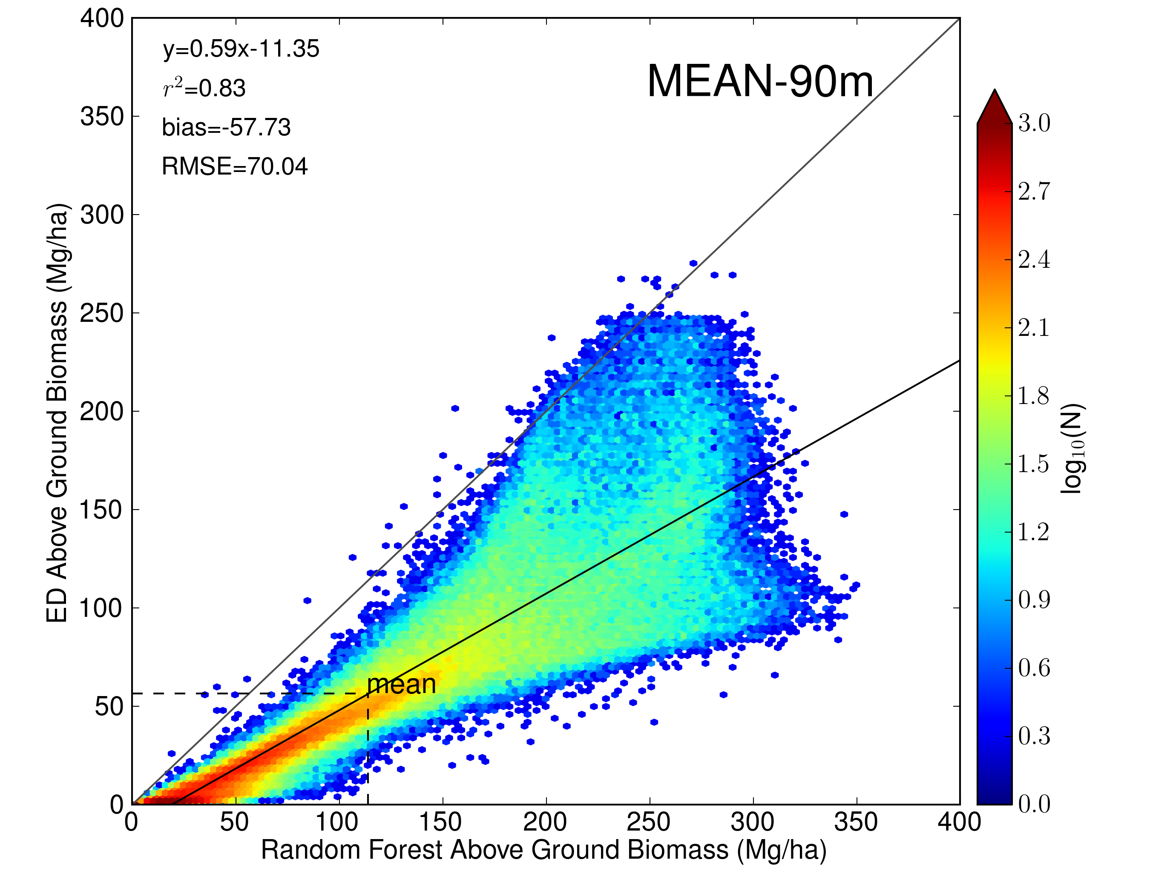
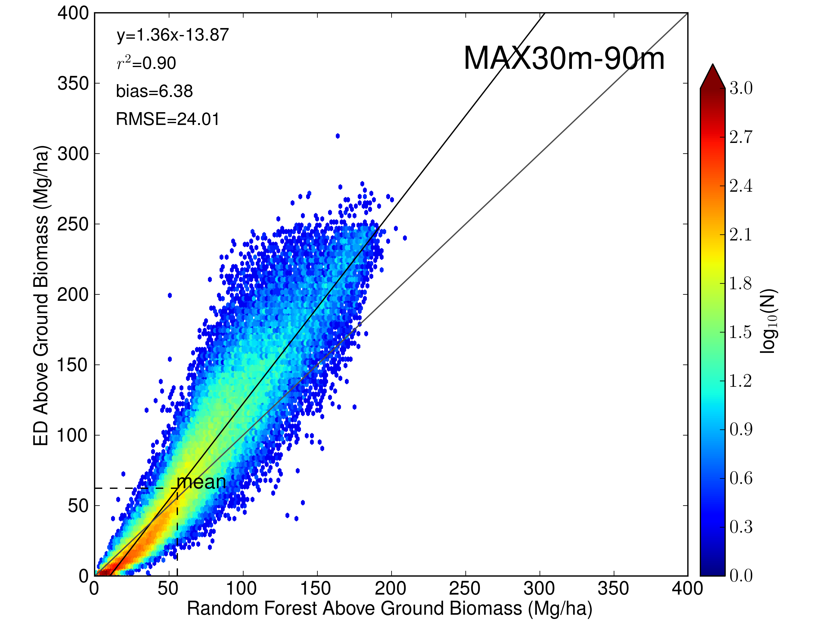
Phase 1: 2,181 km2

Slide 3
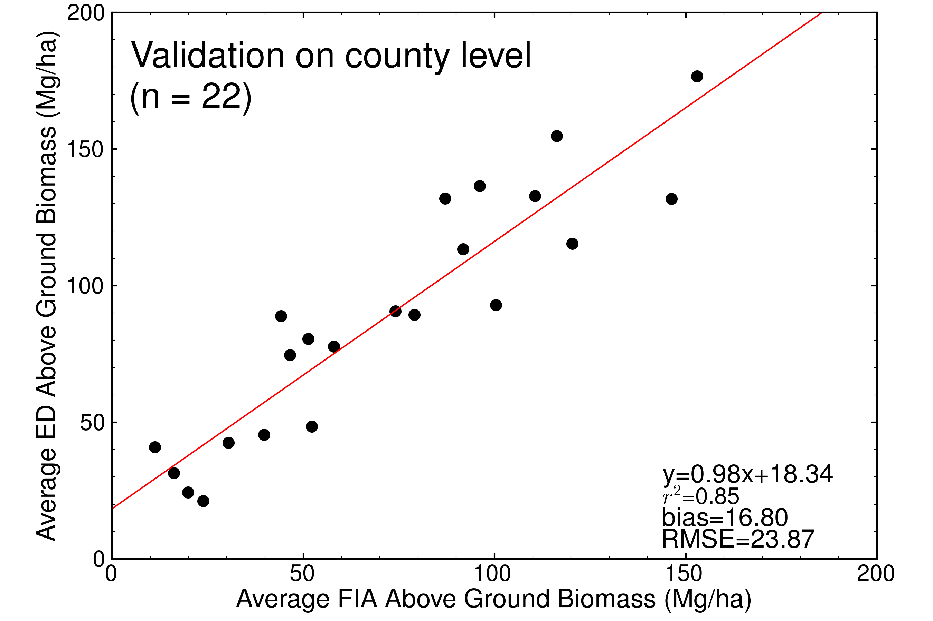
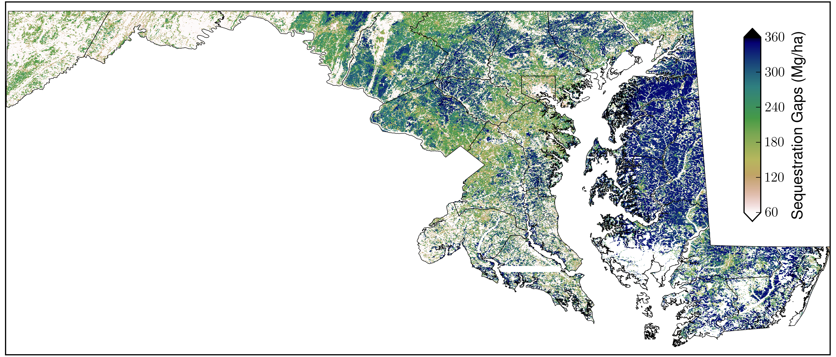
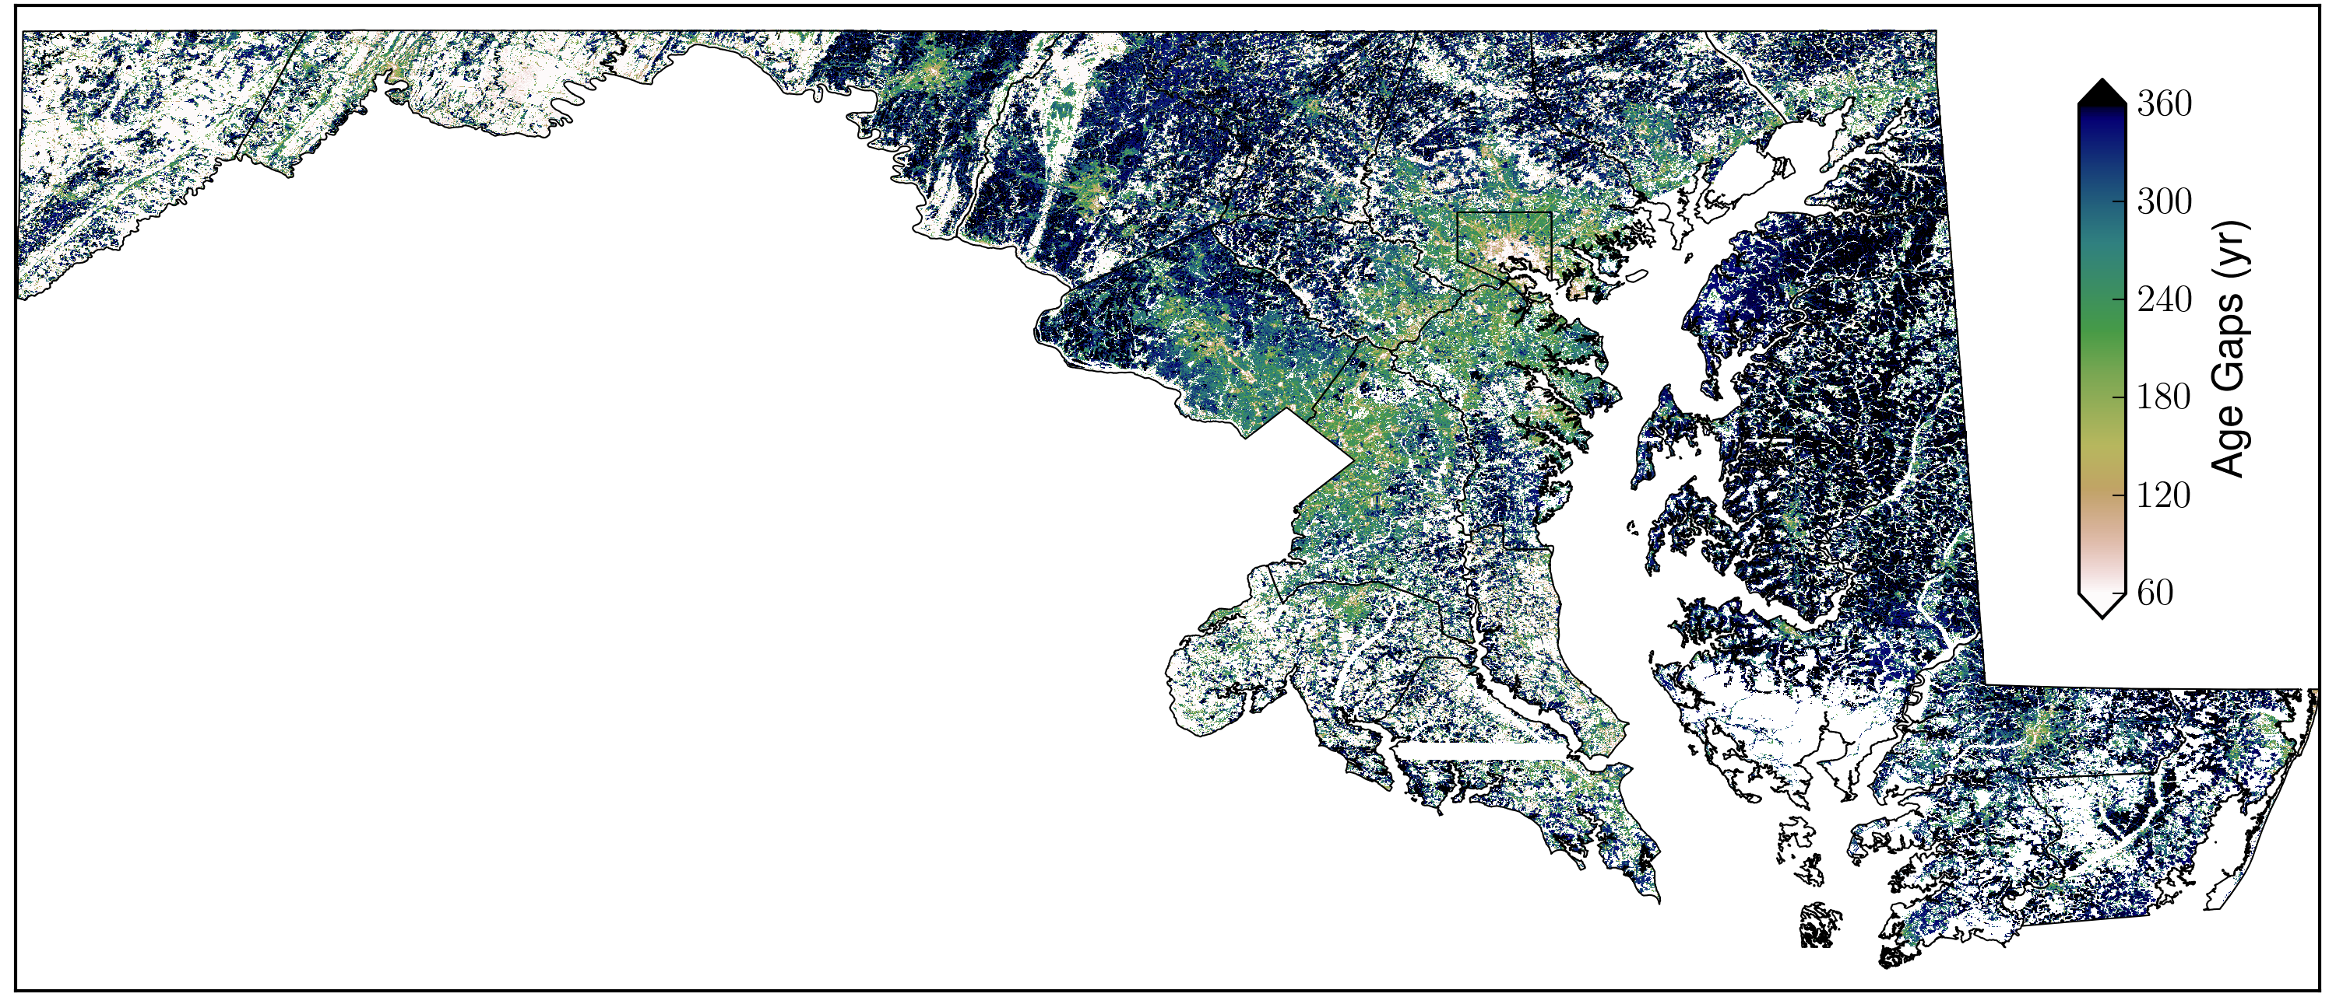
Maps:
Forest Cover
Height
Biomass
Biomass-ED
NEP-ED
Carbon Sequestration Gap=
204.15 TgC
Mean = 191.41 Mg/ha
CSG Time Interval
Mean = 228.17 y
Phase 2a: 32,133 km2

Slide 4
Phase 2c Objectives
Improve methodology for carbon stock estimation and uncertainty
Provide high spatial resolution mapping of carbon stock and uncertainty for 3-state region (MD,PA, DE)
Initialize and run prognostic ecosystem model for carbon at high spatial resolution for multiple states
Validate national biomass maps
Develop and test methodology for monitoring changes in biomass
Demonstrate MRV efficacy for 3-state region, and a vision for future national scale deployment
Phase 2c: 157,868 km2

